Slide 1




Kettel Network System
Project Presentation
Created by: Mihálovics József Alex(PM),Vaszlavik Dominik,Németh Kristóf

Slide 2







Introduction
The network connects four main sites and two additional locations:
Kettel Network System:
Szeged
SZ
shop (sales and customer service point)
-Nationwide IT infrastructure
-Reliability
Győr
GY
office (regional administration and customer support)
Budapest
B
Mainsite (central servers, data center, and management)
Pécs
P
office (support and maintenance department)
D
DUNAÚJVÁROS - HR
K
KECSKEMÉT - FINANCE
Kettel Hálózati Rendszer – Projektbemutató
Notes:
Kettel Network System: Our network is a centrally managed, nationwide IT infrastructure that connects sites with secure, encrypted connections.
Purpose: Its purpose is reliable data connection, efficient information flow, and unified central supervision.

Slide 3




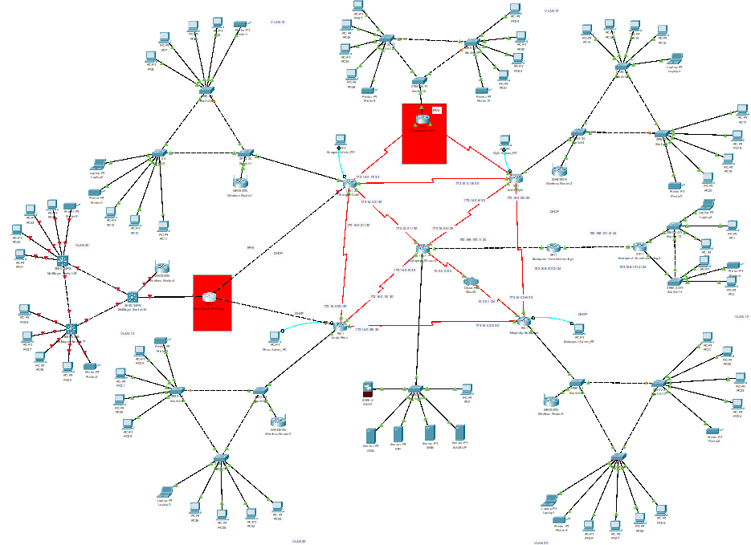




Hálózat Bemutatása
Cisco Packet Tracer - 8.2.2
This network was created in a simulational environment.
Plan de contrôle
Routeur
Kettel Hálózati Rendszer – Projektbemutató
Notes:
The presentation's goal is to demonstrate how the KETTEL network operates. Important: It is important to add that SSH connection is possible with all routers.

Slide 4


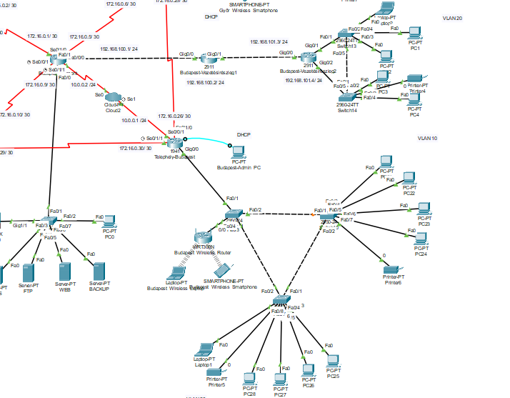
BUDAPEST
DHCP
-BUDAPEST_10 → 192.168.70.0/24
-BUDAPEST_20 → 192.168.80.0/24
-Excluded addresses: .1–.49 és .101–.254
VLAN
-VLAN 10 – 192.168.70.1
-VLAN 20 – 192.168.80.1
-Inter-VLAN routing: performed by router
Routing
-OSPF
-Connection to other sites via OSPF
ACL
-Denies traffic between VLAN 10 ↔ VLAN 20
-Denies direct access to networks in other cities
VPN
-Encryption is active at the Management department
Kettel Hálózati Rendszer – Projektbemutató

Slide 5
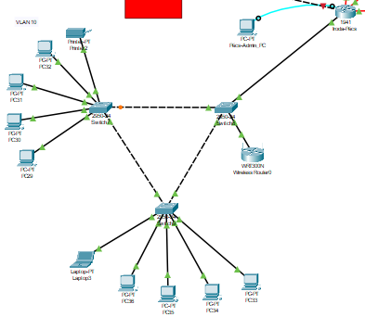
PÉCS
DHCP -PCS_10: 192.168.50.0/24 -PCS_20: 192.168.60.0/24 -Excluded addresses: .1–.49, .101–.254
VLAN -VLAN 10 – 192.168.50.1 -VLAN 20 – 192.168.60.1 -Inter-VLAN routing: performed by the router
Routing -OSPF -WAN: 172.16.0.8/30, .20/30, .28/30
ACL -VLAN 10 ↔ VLAN 20 Denied -Denies direct access to networks in other cities(192.168.10–40, 70–80.0/24) -ACL 100
Kettel Hálózati Rendszer – Projektbemutató

Slide 6
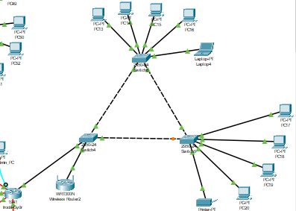
GYŐR
DHCP -GYR_10: 192.168.30.0/24 -GYR_20: 192.168.40.0/24 -Excluded: .1–.49, .101–.254
VLAN -VLAN 10 – 192.168.30.1 -VLAN 20 – 192.168.40.1 -Inter-VLAN routing: router
Routing -OSPF
-Static route -WAN: 172.16.0.4/30, .16/30, .24/30
ACL -VLAN 10 ↔ VLAN 20 tiltva -Other sites denied (192.168.10,20,50–80.0/24) -ACL 100
Nat
-Static and dynamic address translation
Kettel Hálózati Rendszer – Projektbemutató
Kettel Hálózati Rendszer – Projektbemutató

Slide 7
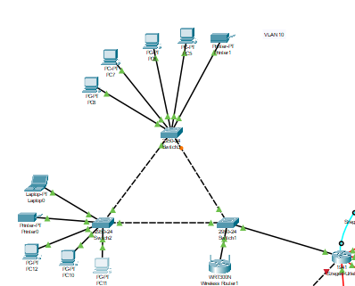
SZEGED
DHCP és DHCPV6 -SZEGED_10: 192.168.10.0/24 -SZEGED_20: 192.168.20.0/24 -Excluded addresses: .1–.49, .101–.254
-(Dual stack)
VLAN -VLAN 10 – 192.168.10.1 -VLAN 20 – 192.168.20.1 -Inter-VLAN routing: performed by the router
Routing -OSPF -Static route -WAN network: 172.16.0.0/30, .16/30, .20/30
ACL -VLAN 10 ↔ VLAN 2 Denied -Other sites denied (192.168.30–80.0/24) -ACL 100
Kettel Hálózati Rendszer – Projektbemutató

Slide 8
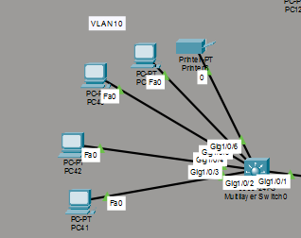
KECSKEMÉT - PÉNZÜGY
DHCP -10.0.0.0/8
VLAN -VLAN 10 – 10.0.0.10 -Inter-VLAN routing: perfomed by multilayer switch
Routing -OSPF
Multilayer SW
Kettel Hálózati Rendszer – Projektbemutató

Slide 9
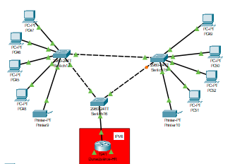
DUNAÚJVÁROS - HR
DHCPv6 -DHCPv6 : 2001:DB8:ACAD:2::1/64
VLAN -VLAN 10 – -VLAN 20 – -Inter-VLAN routing: performed by the router
Routing -OSPFv3,
IPv6 -IPv6 unicast-routing is enabled,
Kettel Hálózati Rendszer – Projektbemutató
Kettel Hálózati Rendszer – Projektbemutató

Slide 10
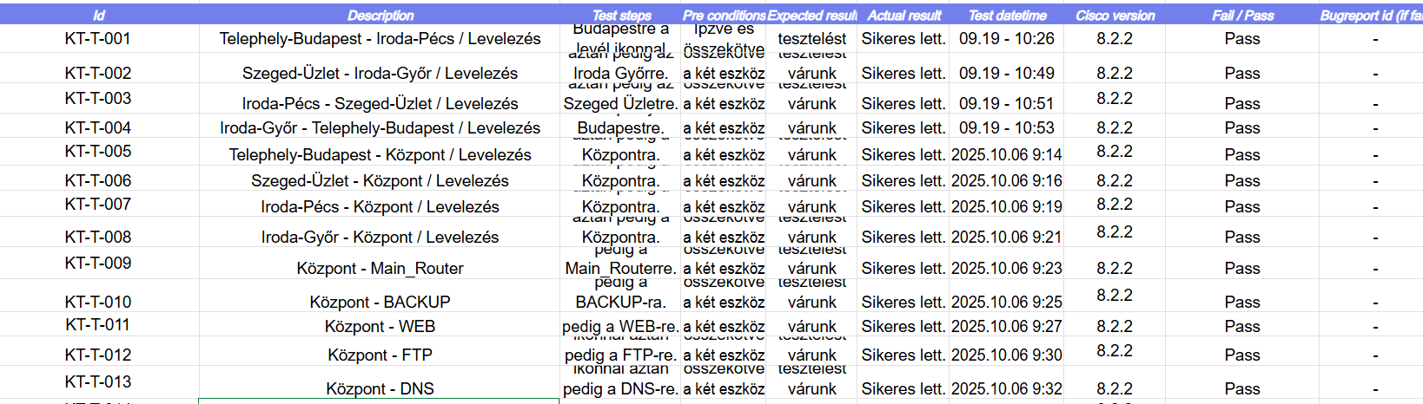
TESTING

Slide 11
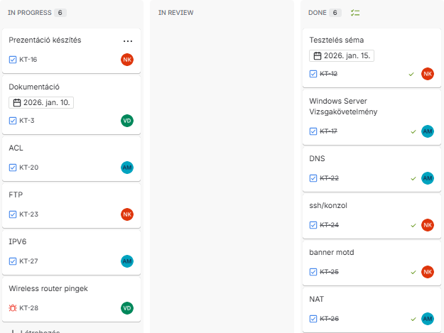
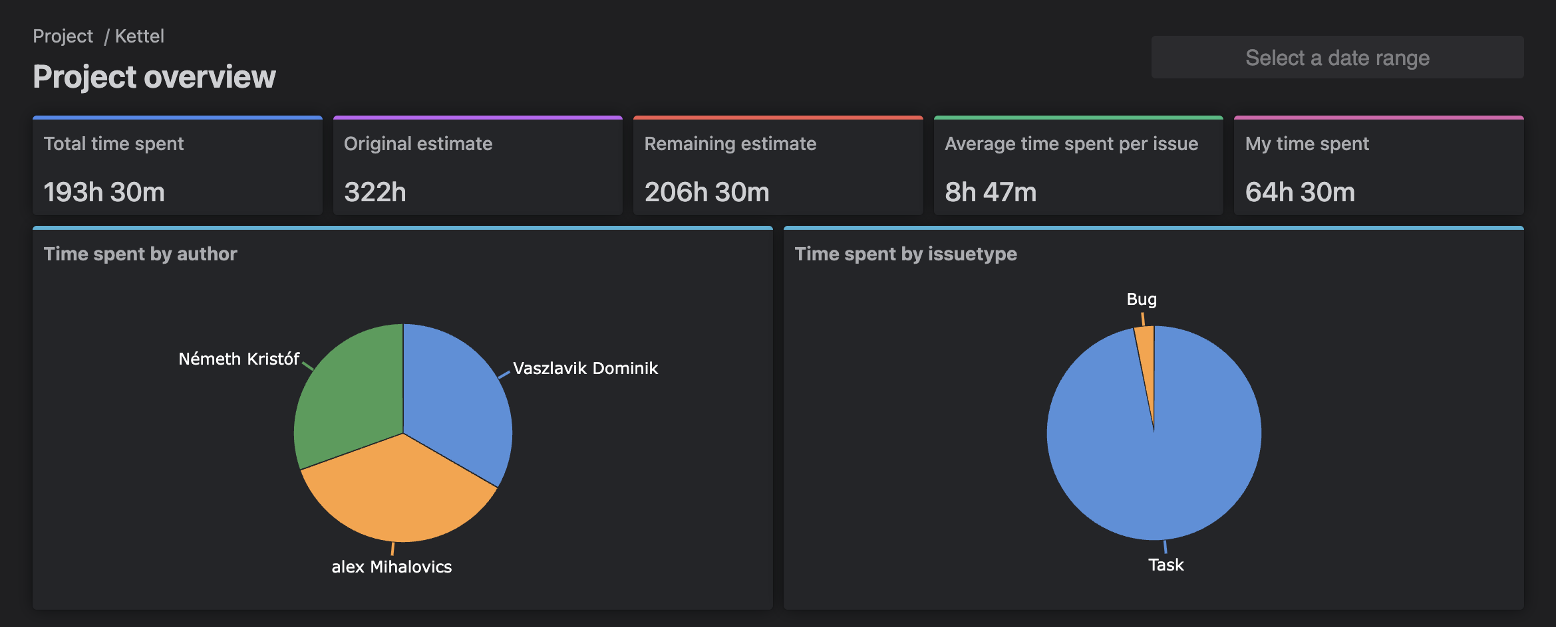
Jira (Atlassian)
What is the purpose of using Jira in our team?
How does it work?
Why is JIRA good?
Measurability and Transparency
Kettel Hálózati Rendszer – Projektbemutató

Slide 12

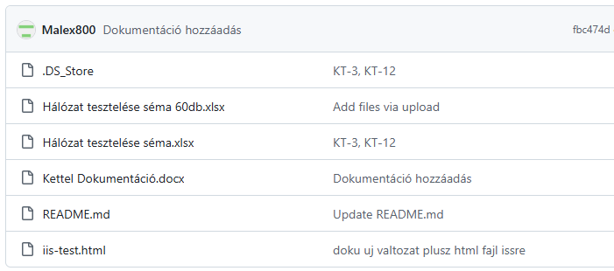
GITHUB
What do we use it for?
Why is GitHub good?

Slide 13
Thank you very much for your attention!

